Slide 1





Slide 2










MP

Slide 3
And so on…
Third
Starting Area
Second
Gates

Slide 4
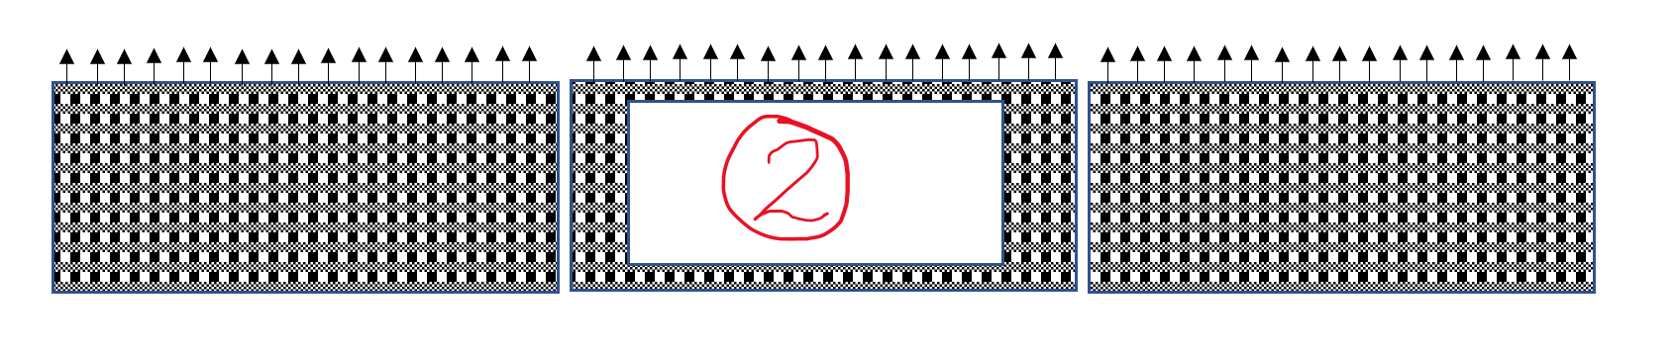
OPEN

Slide 5
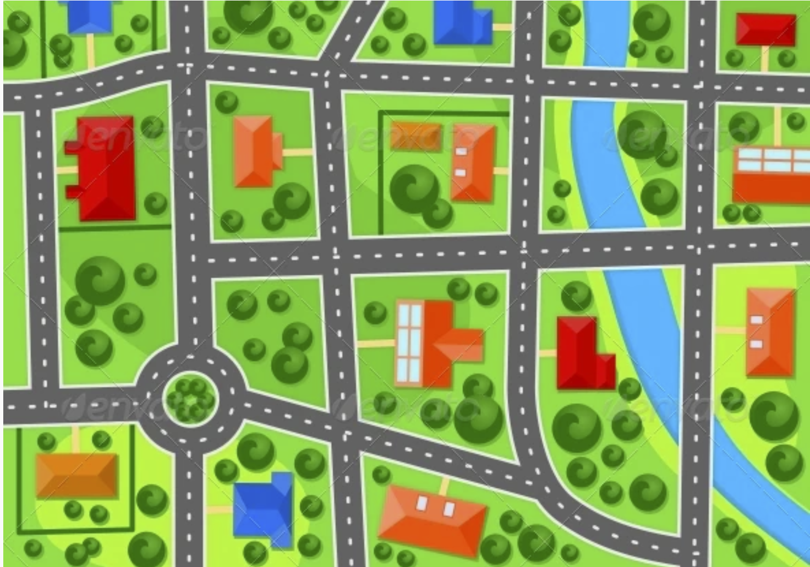
Experienced
Intermediate
Start Area
Maxed
Beginner
Gates

Slide 6

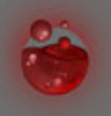
L2
R2
Available Attack
Blocked Attack
MutagenPoints
Waves
Health
[n] MPs
Lost Health
[n] Waves

